Slide 1
Introduction of Deep Reinforcement Learning (RL)
Hung-yi Lee
Notes:
http://incompleteideas.net/book/RLbook2020.pdf
SARSA
What is the best?
Basic idea of RL
Policy gradient
Q-learning
AC
Issue of RL (sparse reward)
IRL
=========================================
and its relation with GAN
Scenario 1: Learning by demonstration
Also known as imitation learning, apprenticeship learning
An expert demonstrates how to solve the task, and machine learns from it.
Ref: https://www.youtube.com/watch?v=rOho-2oJFeA
Scenario 2: Reinforcement Learning
Machine demonstrates itself by interaction with the environment.
Machine obtains the reward from the environment, so it knows a demonstration is good or bad.
Ref: https://www.youtube.com/watch?v=W8XF3ME8G2I

Slide 2


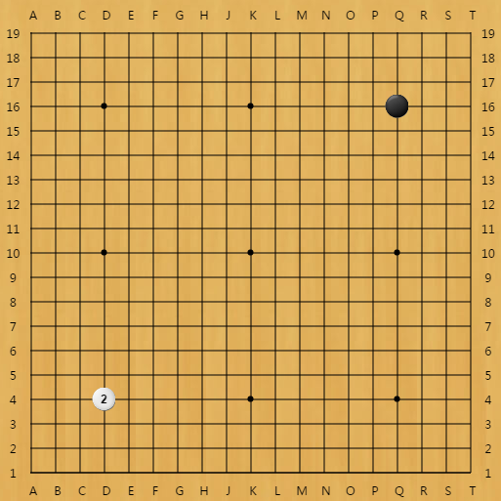
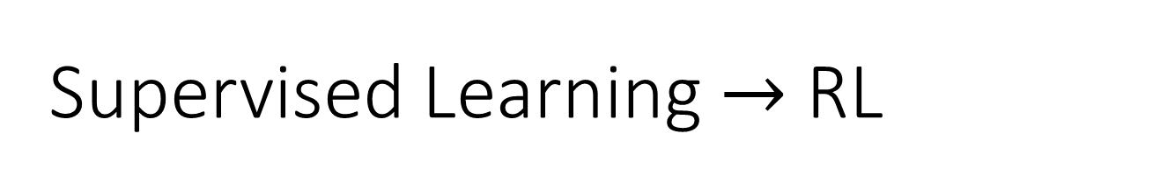
Supervised Learning $→$ RL
Human label
?
Cat
Human label
?
“3-3”?
It is challenging to label data in some tasks.
…… machine can know the results are good or not.

Slide 3
Outline
What is RL? (Three steps in ML)
Policy Gradient
Actor-Critic
Reward Shaping
No Reward: Learning from Demonstration

Slide 4

Machine Learning ≈ Looking for a Function
Actor
Observation
Action
Action = f( Observation )
Function input
Function
output
Find a policy maximizing total reward
Reward
Environment

Slide 5
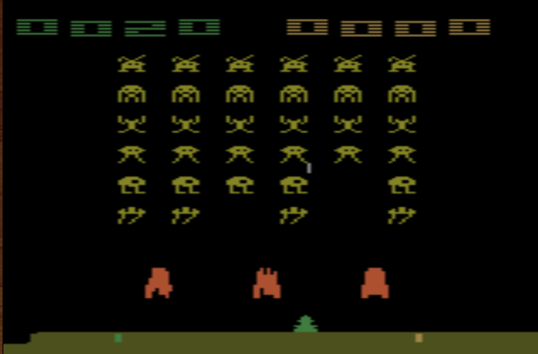
Example: Playing Video Game
Termination: all the aliens are killed, or your spaceship is destroyed.
Space invader
Score (reward)
Kill the aliens
shield
fire
Notes:
Can I play it???
====
Widely studies:
Gym: https://gym.openai.com/
Universe: https://openai.com/blog/universe/
Machine learns to play video games as human players
What machine observes is pixels
Machine learns to take proper action itself

Slide 6

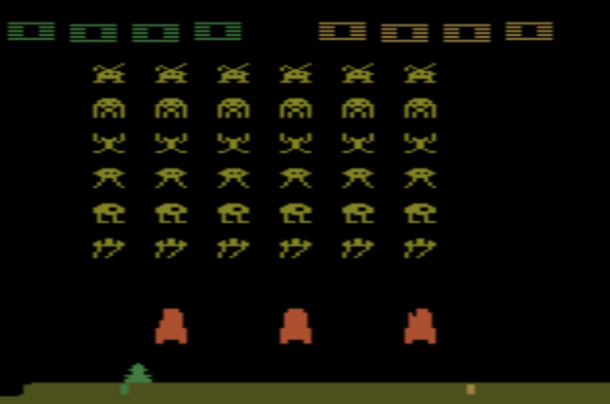
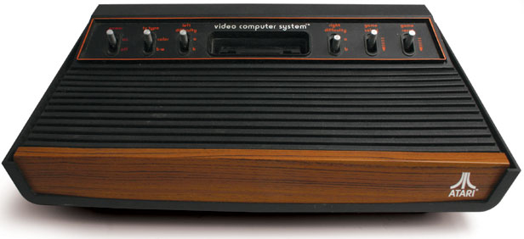
Example: Playing Video Game
Actor
Observation
Action
“right”
Reward
reward = 0
Environment

Slide 7
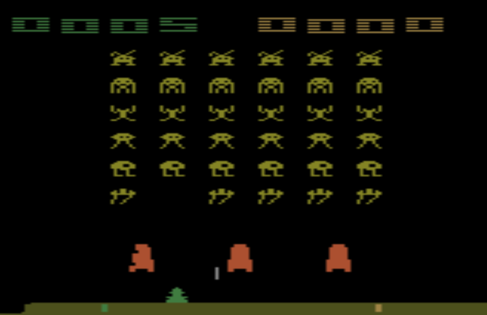
Example: Playing Video Game
Find an actor maximizing expected reward.
Actor
Observation
Action
“fire”
Reward
reward = 5
if killing an alien.
Environment

Slide 8
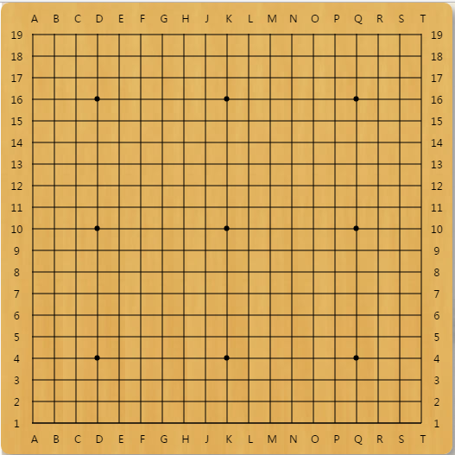

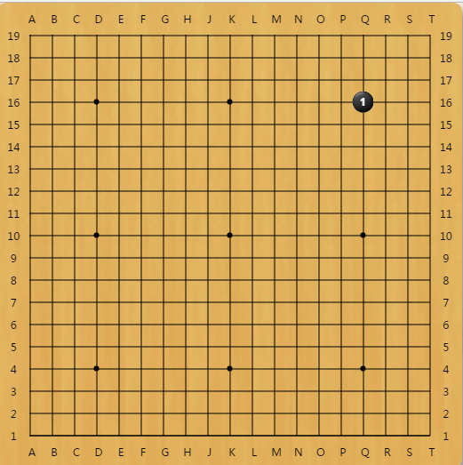
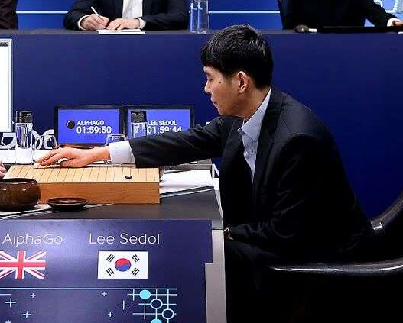
Example: Learning to play Go
Observation
Action
Reward
Next Move
Environment

Slide 9
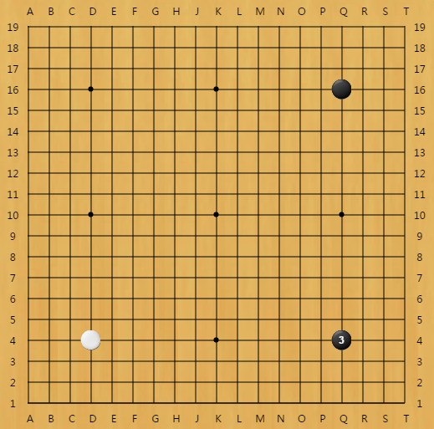
Example: Learning to play Go
Find an actor maximizing expected reward.
Observation
Action
Reward
reward = 0 in most cases
If win, reward = 1
If loss, reward = -1
Environment

Slide 10
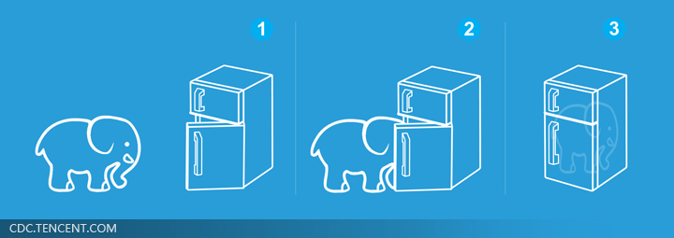
Machine Learning is so simple ……
Step 1: function with unknown
Step 2: define loss from training data
Step 3: optimization

Slide 11
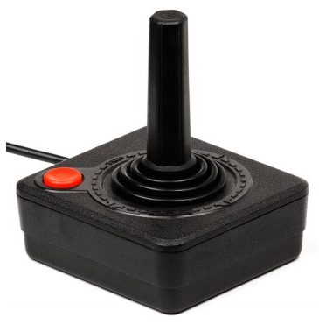
Step 1: Function with Unknown
Policy Network (Actor)
Sample based on scores
left
0.7
…
right
0.2
Scores of actions
…
fire
0.1
pixels
Classification Task!!!
Input of neural network: the observation of machine represented as a vector or a matrix
Output neural network : each action corresponds to a neuron in output layer
Notes:
Taking the action with the highest score
===
What is the benefit of using network instead of lookup table?
generalization

Slide 12
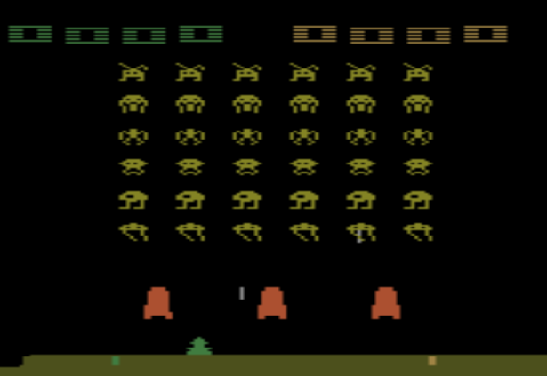
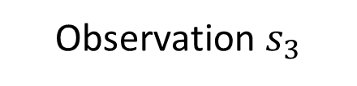
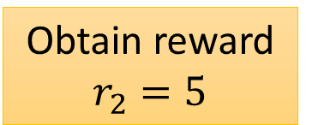
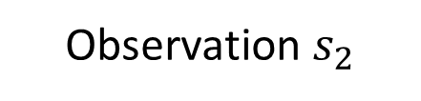
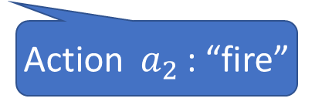
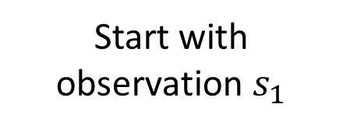
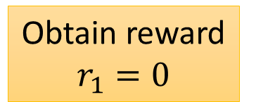
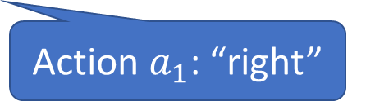
Step 2: Define “Loss”
Start with observation $s_{1}$
Observation $s_{2}$
Observation $s_{3}$
Obtain reward $r_{1}=0$
Obtain reward $r_{2}=5$
Action $a_{1}$: “right”
Action $a_{2}$: “fire”
(kill an alien)

Slide 13
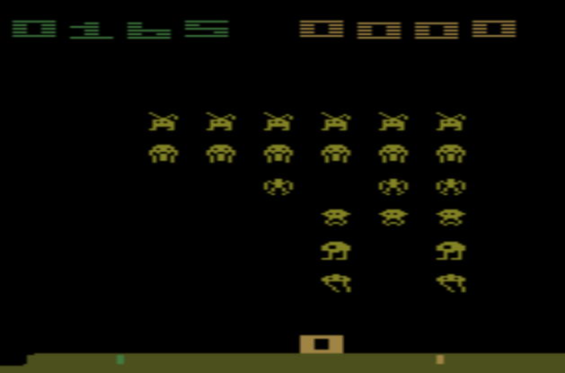
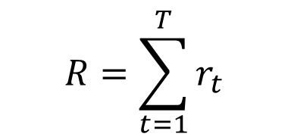
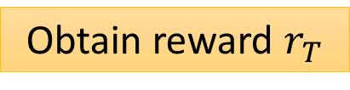
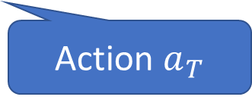
Step 2: Define “Loss”
Start with observation $s_{1}$
Observation $s_{2}$
Observation $s_{3}$
This is an episode.
After many turns
Total reward (return):
Game Over
(spaceship destroyed)
$$R=\sum_{t=1}^{T}{r_{t}}$$
Obtain reward $r_{T}$
What we want to maximize
Action $a_{T}$
Notes:
return

Slide 14
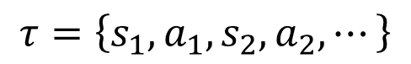
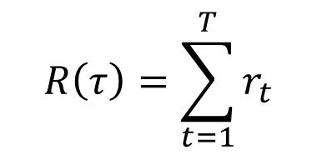
Step 3: Optimization
Trajectory
$$τ=\left\{s_{1},a_{1}, s_{2},a_{2}, ⋯\right\}$$
Network
Network
$$s_{1}$$
$$a_{1}$$
$$s_{2}$$
$$a_{2}$$
Env
Actor
Env
Actor
Env
……
$$s_{1}$$
$$a_{1}$$
$$s_{2}$$
$$a_{2}$$
$$s_{3}$$
Reward
sample
Reward
They are black box …
$$r_{1}$$
$$r_{2}$$
… with randomness
How to do the optimization here is the main challenge in RL.
$$R\left(τ\right)=\sum_{t=1}^{T}{r_{t}}$$
c.f. GAN

Slide 15
Outline
To learn more about policy gradient:
https://youtu.be/W8XF3ME8G2I
What is RL? (Three steps in ML)
Policy Gradient
Actor-Critic
Reward Shaping
No Reward: Learning from Demonstration

Slide 16
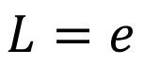
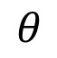
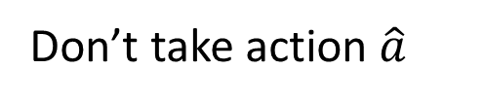
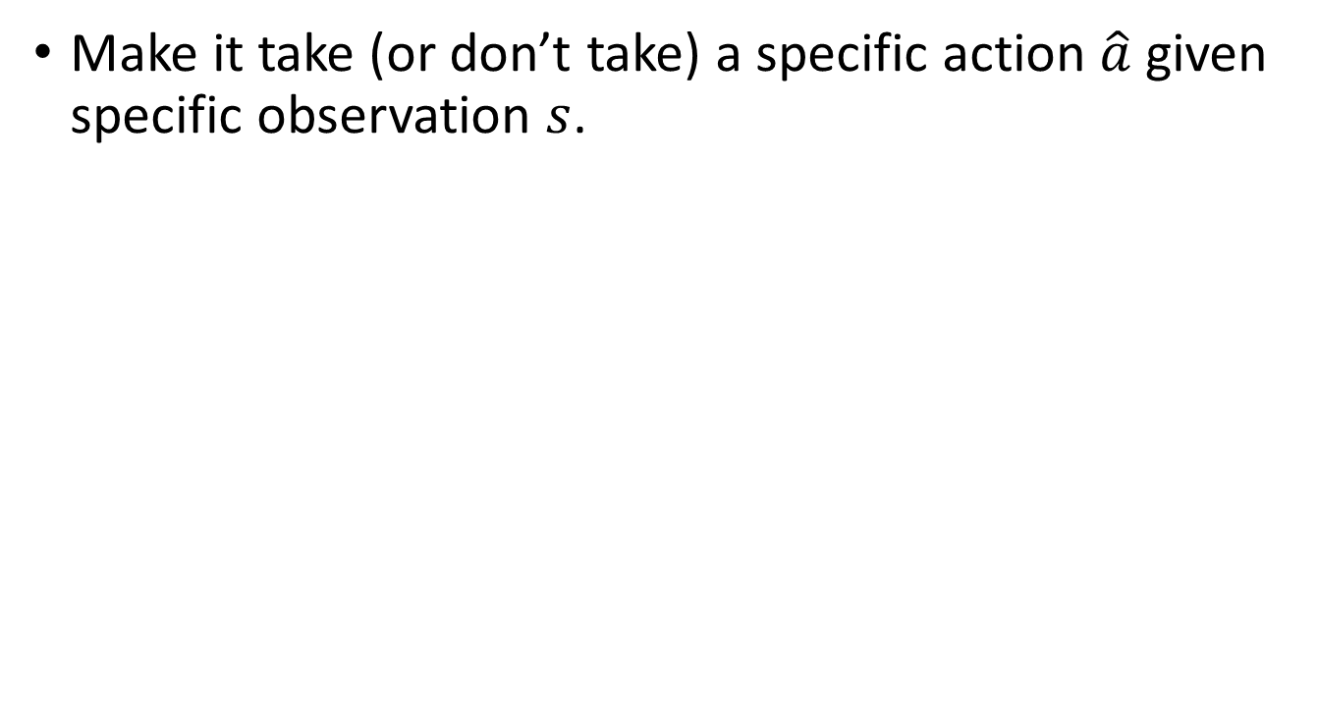
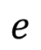
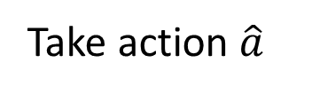
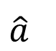
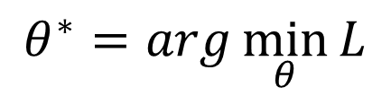
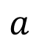
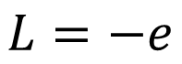
How to control your actor
Make it take (or don’t take) a specific action $\hat{a}$ given specific observation $s$.
$$a$$
$$\hat{a}$$
left
1
Actor
right
0
$$θ$$
s
fire
0
$$e$$
Take action $\hat{a}$
Cross-entropy
$$L=e$$
Don’t take action $\hat{a}$
$$θ^{∗}=arg\min_{θ}{L}$$
$$L=−e$$

Slide 17
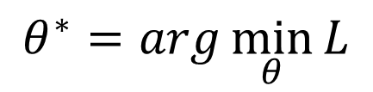
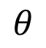
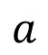
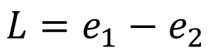
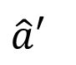
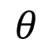
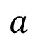
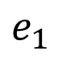
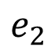
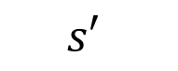
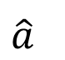
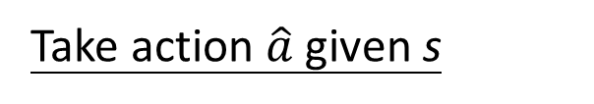
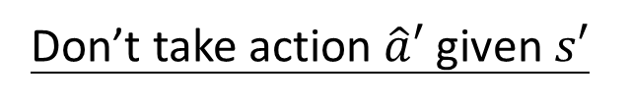
How to control your actor
Take action $\hat{a}$ given s
$$a$$
$$e_{1}$$
$$\hat{a}$$
left
1
Actor
right
0
$$θ$$
s
fire
0
Don’t take action $\hat{a}′$ given $s′$
$$a$$
$$e_{2}$$
$$\hat{a}′$$
left
0
Actor
right
1
$$θ$$
$$s′$$
fire
0
$$L=e_{1}−e_{2}$$
$$θ^{∗}=arg\min_{θ}{L}$$

Slide 18
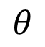








How to control your actor
Training Data
+1
Actor
$$\left\{s_{1},{\hat{a}}_{1}\right\}$$
Yes
$$s$$
$$a$$
$$\left\{s_{2},{\hat{a}}_{2}\right\}$$
-1
$$θ$$
No
$$\left\{s_{3},{\hat{a}}_{3}\right\}$$
+1
Yes
$$L=+ e_{1}−e_{2}+e_{3}⋯−e_{N}$$
……
……
$$θ^{∗}=arg\min_{θ}{L}$$
$$\left\{s_{N},{\hat{a}}_{N}\right\}$$
-1
No

Slide 19






How to control your actor
Training Data
$$A_{1}$$
Actor
$$\left\{s_{1},{\hat{a}}_{1}\right\}$$
+1.5
$$s$$
$$a$$
$$\left\{s_{2},{\hat{a}}_{2}\right\}$$
$$A_{2}$$
- 0.5
$$θ$$
$$\left\{s_{3},{\hat{a}}_{3}\right\}$$
$$A_{3}$$
+0.5
$$L=\sum{{A_{n}e}_{n}}$$
……
……
$$\left\{s_{N},{\hat{a}}_{N}\right\}$$
$$A_{N}$$
$$θ^{∗}=arg\min_{θ}{L}$$
-10
?
?

Slide 20





















Version 0
$$s_{1}$$
$$a_{1}$$
$$s_{2}$$
Training Data
Env
Actor
Env
Actor
$$\left\{s_{1},a_{1}\right\}$$
$$A_{1}$$
$$=r_{1}$$
$$\left\{s_{2},a_{2}\right\}$$
$$A_{2}$$
$$=r_{2}$$
$$s_{1}$$
$$a_{1}$$
$$s_{2}$$
$$a_{2}$$
$$\left\{s_{3},a_{3}\right\}$$
$$A_{3}$$
$$=r_{3}$$
Reward
Reward
……
……
……
$$r_{1}$$
$$r_{2}$$
$$\left\{s_{N},a_{N} \right\}$$
$$A_{N}$$
$$=r_{N}$$
many episodes
Short-sighted Version!
Notes:
只圖一時爽

Slide 21







Version 0
$$s_{1}$$
$$a_{1}$$
$$s_{2}$$
Env
Actor
Env
Actor
$$s_{1}$$
An action affects the subsequent observations and thus subsequent rewards.
Reward delay: Actor has to sacrifice immediate reward to gain more long-term reward.
In space invader, only “fire” yields positive reward, so vision 0 will learn an actor that always “fire”.
$$a_{1}$$
$$s_{2}$$
$$a_{2}$$
“right”
“fire”
Reward
Reward
……
?
$$r_{1}$$
0
$$r_{2}$$
+5

Slide 22



























Version 1
Training Data
$$s_{1}$$
$$s_{2}$$
$$s_{3}$$
$$s_{N}$$
$$\left\{s_{1},a_{1}\right\}$$
$$A_{1}$$
$$=G_{1}$$
$$a_{1}$$
$$a_{2}$$
$$a_{3}$$
……
$$a_{N}$$
$$\left\{s_{2},a_{2}\right\}$$
$$A_{2}$$
$$=G_{2}$$
$$r_{1}$$
$$r_{2}$$
$$r_{3}$$
$$r_{N}$$
$$\left\{s_{3},a_{3}\right\}$$
$$A_{3}$$
$$=G_{3}$$
……
……
$$G_{1}=r_{1}+r_{2}+r_{3}+\text{……}+r_{N}$$
$$\left\{s_{N},a_{N}\right\}$$
$$A_{N}$$
$$=G_{N}$$
$$G_{2}=r_{2}+r_{3}+\text{……}+r_{N}$$
$$G_{t}=\sum_{n=t}^{N}{r_{n}}$$
$$G_{3}=r_{3}+\text{……}+r_{N}$$
cumulated reward
Notes:
Consider credit assignment

Slide 23








Version 2
Training Data
$$s_{1}$$
$$s_{2}$$
$$s_{3}$$
$$s_{N}$$
$$\left\{s_{1},a_{1}\right\}$$
$$A_{1}$$
$$=G_{1}^{′}$$
$$a_{1}$$
$$a_{2}$$
$$a_{3}$$
……
$$a_{N}$$
$$\left\{s_{2},a_{2}\right\}$$
$$A_{2}$$
$$=G_{2}^{′}$$
$$r_{1}$$
$$r_{2}$$
$$r_{3}$$
$$r_{N}$$
$$\left\{s_{3},a_{3}\right\}$$
$$A_{3}$$
$$=G_{3}^{′}$$
Also the credit of $a_{1}$?
……
……
$$G_{1}=r_{1}+r_{2}+r_{3}+\text{……}+r_{N}$$
$$\left\{s_{N},a_{N}\right\}$$
$$A_{N}$$
$$=G_{N}^{′}$$
$$G_{1}^{′}=r_{1}+γr_{2}+γ^{2}r_{3}+\text{……}$$
$$G_{t}^{′}=\sum_{n=t}^{N}{γ^{n−t}r_{n}}$$
Discount factor
$$γ<1$$
Notes:
Consider credit assignment

Slide 24









Version 3
Training Data
$$s_{1}$$
$$s_{2}$$
$$s_{3}$$
$$s_{N}$$
$$\left\{s_{1},a_{1}\right\}$$
$$A_{1}$$
$$=G_{1}^{′}$$
$$−b$$
$$a_{1}$$
$$a_{2}$$
$$a_{3}$$
……
$$a_{N}$$
$$\left\{s_{2},a_{2}\right\}$$
$$A_{2}$$
$$=G_{2}^{′}$$
$$−b$$
$$r_{1}$$
$$r_{2}$$
$$r_{3}$$
$$r_{N}$$
$$\left\{s_{3},a_{3}\right\}$$
$$A_{3}$$
$$=G_{3}^{′}$$
$$−b$$
……
……
Good or bad reward is “relative”
If all the $r_{n}≥10$
$$\left\{s_{N},a_{N}\right\}$$
$$A_{N}$$
$$=G_{N}^{′}$$
$$−b$$
$r_{n}=10$ is negative …
$$G_{t}^{′}=\sum_{n=t}^{N}{γ^{n−t}r_{n}}$$
Minus by a baseline $b$
???
Make $G_{t}^{′}$ have positive and negative values
Notes:
Consider credit assignment

Slide 25

Policy Gradient
Initialize actor network parameters $θ^{0}$
For training iteration $i=1$ to $T$
Using actor $θ^{i−1}$ to interact
Obtain data $\left\{s_{1},a_{1}\right\},\left\{s_{2},a_{2}\right\},…,\left\{s_{N},a_{N}\right\}$
Compute $A_{1},A_{2},…,A_{N}$
Compute loss $L$
$θ^{i}←θ^{i−1}−η∇L$
Data collection is in the “for loop” of training iterations.

Slide 26













Policy Gradient
Training Data
Actor
$$s$$
$$a$$
$$\left\{s_{1},a_{1}\right\}$$
$$A_{1}$$
$$θ$$
$$\left\{s_{2},a_{2}\right\}$$
$$A_{2}$$
$$L=\sum{{A_{n}e}_{n}}$$
$$\left\{s_{3},a_{3}\right\}$$
$$A_{3}$$
……
……
$$θ^{i}←θ^{i−1}−η∇L$$
$$\left\{s_{N},a_{N}\right\}$$
$$A_{N}$$
only update once
Each time you update the model parameters, you need to collect the whole training set again.

Slide 27



Policy Gradient
Initialize actor network parameters $θ^{0}$
For training iteration $i=1$ to $T$
Using actor $θ^{i−1}$ to interact
Obtain data $\left\{s_{1},a_{1}\right\},\left\{s_{2},a_{2}\right\},…,\left\{s_{N},a_{N}\right\}$
Compute $A_{1},A_{2},…,A_{N}$
Compute loss $L$
$θ^{i}←θ^{i−1}−η∇L$
Experience of $θ^{i−1}$
May not be good for $θ^{i}$

Slide 28


棋魂第八集

Slide 29


棋魂第八集

Slide 30





Policy Gradient
Initialize actor network parameters $θ^{0}$
For training iteration $i=1$ to $T$
Using actor $θ^{i−1}$ to interact
Obtain data $\left\{s_{1},a_{1}\right\},\left\{s_{2},a_{2}\right\},…,\left\{s_{N},a_{N}\right\}$
Compute $A_{1},A_{2},…,A_{N}$
Compute loss $L$
$θ^{i}←θ^{i−1}−η∇L$
May not observe by $θ^{i}$
$$s_{1}$$
$$s_{2}$$
$$s_{3}$$
$$s_{N}$$
Trajectory of $θ^{i−1}$
$$a_{1}$$
$$a_{2}$$
$$a_{3}$$
……
$$a_{N}$$
$$r_{1}$$
$$r_{2}$$
$$r_{3}$$
$$r_{N}$$

Slide 31






On-policy v.s. Off-policy
The actor to train and the actor for interacting is the same. $→$ On-policy
Can the actor to train and the actor for interacting be different? $→$ Off-policy
$$s_{1}$$
$$s_{2}$$
$$s_{3}$$
$$s_{N}$$
Trajectory of $θ^{i−1}$
……
$$a_{1}$$
$$a_{2}$$
$$a_{3}$$
$$a_{N}$$
To train $θ^{i}$
$$r_{1}$$
$$r_{2}$$
$$r_{3}$$
$$r_{N}$$
In this way, we do not have to collection data after each update.

Slide 32



Off-policy $→$ Proximal Policy Optimization (PPO)
The actor to train has to know its difference from the actor to interact.
video: https://youtu.be/OAKAZhFmYoI
Not apply to everyone
the actor to train
the actor to interact
https://disp.cc/b/115-bLHe

Slide 33
Collection Training Data: Exploration
$$s_{1}$$
$$a_{1}$$
$$s_{2}$$
Enlarge output entropy
Env
Actor
Env
Actor
$$s_{1}$$
$$a_{1}$$
$$s_{2}$$
$$a_{2}$$
Add noises onto parameters
Reward
Reward
……
Suppose your actor always takes “left”.
$$r_{1}$$
$$r_{2}$$
The actor needs to have randomness during data collection.
We never know what would happen if taking “fire”.
A major reason why we sample actions. ☺
Notes:
只圖一時爽

Slide 34

DeepMind - PPO
https://youtu.be/gn4nRCC9TwQ
Notes:
Deep mind

Slide 35

OpenAI - PPO
https://blog.openai.com/openai-baselines-ppo/
Notes:
openAI

Slide 36
Outline
What is RL? (Three steps in ML)
Policy Gradient
Actor-Critic
Reward Shaping
No Reward: Learning from Demonstration

Slide 37








Critic
$$G_{1}^{′}=r_{1}+γr_{2}+γ^{2}r_{3}+\text{……}$$
Critic: Given actor $θ$, how good it is when observing $s$ (and taking action $a$)
Value function $V^{θ}\left(s\right)$: When using actor $θ$, the discounted cumulated reward expects to be obtained after seeing s
$$V^{θ}$$
$$V^{θ}\left(s\right)$$
s
scalar
$V^{θ}\left(s\right)$ is large
$V^{θ}\left(s\right)$ is smaller
The output values of a critic depend on the actor evaluated.
Notes:
(Lots of aliens to be killed, and the shields still exist)

Slide 38













How to estimate $V^{θ}\left(s\right)$
Monte-Carlo (MC) based approach
The critic watches actor $θ$ to interact with the environment.
After seeing $s_{a}$,
$$V^{θ}$$
Until the end of the episode, the cumulated reward is $G_{a}^{′}$
$$s_{a}$$
$$V^{θ}\left(s_{a}\right)$$
$$G_{a}^{′}$$
After seeing $s_{b}$,
$$V^{θ}$$
Until the end of the episode, the cumulated reward is $G_{b}^{′}$
$$s_{b}$$
$$V^{θ}\left(s_{b}\right)$$
$$G_{b}^{′}$$
Notes:
The critic watches actor $θ$ to interact with environment.
The critic watches actor $θ$ to interact with environment.

Slide 39














How to estimate $V^{π}\left(s\right)$
Temporal-difference (TD) approach
$$⋯s_{t},a_{t},r_{t},s_{t+1}⋯$$
(ignore the expectation here)
$$V^{θ}\left(s_{t}\right)=r_{t}+γr_{t+1}+γ^{2}r_{t+2}…$$
$$V^{θ}\left(s_{t+1}\right)=r_{t+1}+γr_{t+2}+…$$
$$V^{θ}$$
$$V^{θ}\left(s_{t}\right)=γV^{θ}\left(s_{t+1} \right)+r_{t}$$
$$s_{t}$$
$$V^{θ}\left(s_{t}\right)$$
-
$$V^{θ}\left(s_{t}\right)−γV^{θ}\left(s_{t+1}\right)$$
$$r_{t}$$
$$V^{θ}$$
$$×γ$$
$$s_{t+1}$$
$$V^{θ}\left(s_{t+1}\right)$$
Notes:
Some applications have very long episodes, so that delaying all learning until an episode's end is too slow.
===
The next most obvious advantage of TD methods over Monte Carlo methods is
that they are naturally implemented in an on-line, fully incremental fashion. With
Monte Carlo methods one must wait until the end of an episode, because only then
is the return known, whereas with TD methods one need wait only one time step.
Surprisingly often this turns out to be a critical consideration Other applications are continuing tasks and have no episodes at all.

Slide 40






MC v.s. TD
[Sutton, v2, Example 6.4]
The critic has observed the following 8 episodes
$s_{a},r=0,s_{b},r=0$, END
$s_{b},r=1$, END
$s_{b},r=1$, END
$s_{b},r=1$, END
$s_{b},r=1$, END
$s_{b},r=1$, END
$s_{b},r=1$, END
$s_{b},r=0$, END
$$V^{θ}\left(s_{b}\right)=3/4$$
$$V^{θ}\left(s_{a}\right)=?$$
0?
3/4?
Monte-Carlo:
$$V^{θ}\left(s_{a}\right)=0$$
Temporal-difference:
$$V^{θ}\left(s_{a}\right)=V^{θ}\left(s_{b}\right)+r$$
(Assume $γ$ = 1, and the actions are ignored here.)
3/4
3/4
0

Slide 41





















Version 3.5
$$s_{1}$$
$$s_{2}$$
$$s_{3}$$
$$s_{N}$$
Training Data
$$a_{1}$$
$$a_{2}$$
$$a_{3}$$
……
$$a_{N}$$
$$\left\{s_{1},a_{1}\right\}$$
$$A_{1}$$
$$=G_{1}^{′}$$
$$−b$$
$$r_{1}$$
$$r_{2}$$
$$r_{3}$$
$$r_{N}$$
$$\left\{s_{2},a_{2}\right\}$$
$$A_{2}$$
$$=G_{2}^{′}$$
$$−b$$
$$\left\{s_{3},a_{3}\right\}$$
$$A_{3}$$
$$=G_{3}^{′}$$
$$−b$$
……
……
$$V^{θ}$$
$$V^{θ}\left(s\right)$$
$$\left\{s_{N},a_{N}\right\}$$
$$A_{N}$$
$$=G_{N}^{′}$$
$$−b$$
s
Notes:
Consider credit assignment

Slide 42




Version 3.5
$$s_{1}$$
$$s_{2}$$
$$s_{3}$$
$$s_{N}$$
Training Data
$$a_{1}$$
$$a_{2}$$
$$a_{3}$$
……
$$a_{N}$$
$$\left\{s_{1},a_{1}\right\}$$
$$A_{1}$$
$$=G_{1}^{′}$$
$$−V^{θ}\left(s_{1}\right)$$
$$r_{1}$$
$$r_{2}$$
$$r_{3}$$
$$r_{N}$$
$$\left\{s_{2},a_{2}\right\}$$
$$A_{2}$$
$$=G_{2}^{′}$$
$$−V^{θ}\left(s_{2}\right)$$
$$\left\{s_{3},a_{3}\right\}$$
$$A_{3}$$
$$=G_{3}^{′}$$
$$−V^{θ}\left(s_{3}\right)$$
……
……
$$V^{θ}$$
$$V^{θ}\left(s\right)$$
$$\left\{s_{N},a_{N}\right\}$$
$$A_{N}$$
$$=G_{N}^{′}$$
$$−V^{θ}\left(s_{N}\right)$$
s
Notes:
Consider credit assignment

Slide 43



















Version 3.5
$$\left\{s_{t},a_{t}\right\}$$
$$A_{t}$$
$$=G_{t}^{′}$$
$$−V^{θ}\left(s_{t}\right)$$
$$G=100$$
$$G=3$$
$$G=1$$
$$V^{θ}\left(s_{t}\right)$$
$$s_{t}$$
$$G=2$$
$$G=−10$$
(not necessary take $a_{t}$)
(You sample the actions based on a distribution)
$$A_{t}>0$$
$a_{t}$ is better than average.
$$a_{t}$$
$$G_{t}^{′}$$
$$A_{t}<0$$
$$s_{t}$$
$a_{t}$ is worse than average.
Just a sample
Notes:
Consider credit assignment

Slide 44










Version 4
$$r_{t}+V^{θ}\left(s_{t+1}\right)−V^{θ}\left(s_{t}\right)$$
$$\left\{s_{t},a_{t}\right\}$$
$$A_{t}$$
$$=G_{t}^{′}$$
$$−V^{θ}\left(s_{t}\right)$$
Advantage Actor-Critic
$$G=100$$
$$G=3$$
$$G=1$$
$$V^{θ}\left(s_{t}\right)$$
$$s_{t}$$
$$G=2$$
$$G=−10$$
(not necessary take $a_{t}$)
$$G=101$$
Obtain $r_{t}$
$$G=4$$
$$a_{t}$$
$$r_{t}$$
$$G=3$$
$$+V^{θ}\left(s_{t+1}\right)$$
$$s_{t}$$
$$s_{t+1}$$
$$G=1$$
$$G=−5$$
Notes:
Consider credit assignment

Slide 45

Tip of Actor-Critic
The parameters of actor and critic can be shared.
Network
left
Network
right
Actor
$$s$$
fire
Network
scalar
Critic

Slide 46

Outlook: Deep Q Network (DQN)
Video:
https://youtu.be/o_g9JUMw1Oc
https://youtu.be/2-zGCx4iv_k
https://arxiv.org/abs/1710.02298

Slide 47
Outline
What is RL? (Three steps in ML)
Policy Gradient
Actor-Critic
Reward Shaping
No Reward: Learning from Demonstration

